Slide 1

Sales Forecast Analytics
For
ABC Manufacturing
DATA SCIENCE PRODEGREE PROJECT
Ankita Kshirsagar
Deepti Shekhawat
Vikram Sahu
Niranjan Vidhate

Slide 2
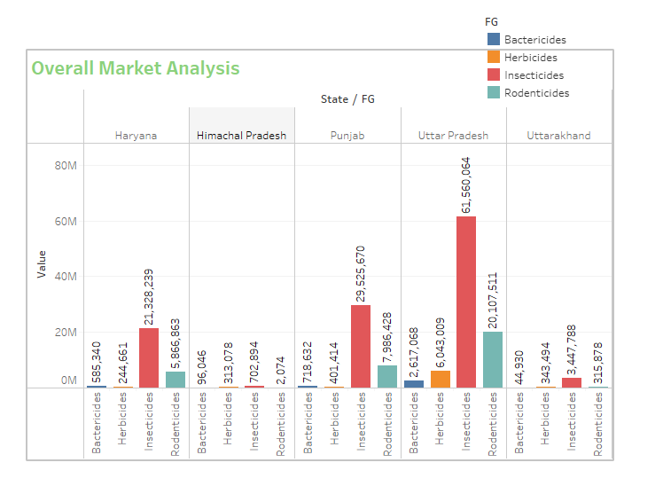
EDA
As per above graph that is overall market analysis following are the observations
1. Out of four Pesticide present in data Insecticides is the higher sold product across all states.
2. Out of five States Uttar Pradesh is highest selling state.

Slide 3
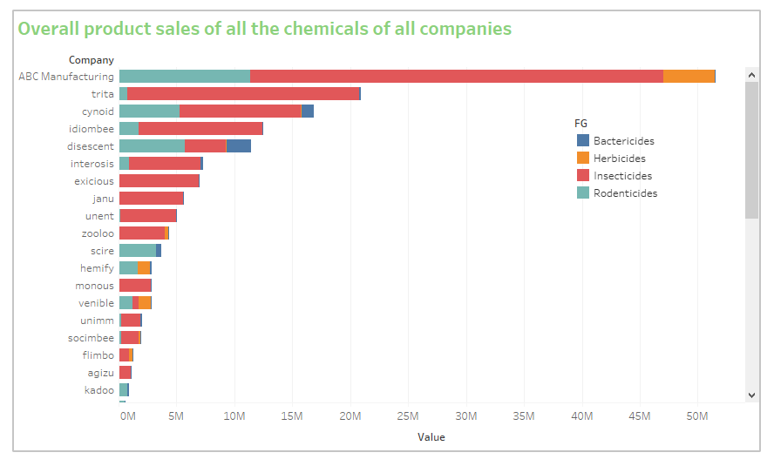
Overall product sales of all the chemicals of all companies
From above graph ABC Manufacturing is the highest selling company.

Slide 4
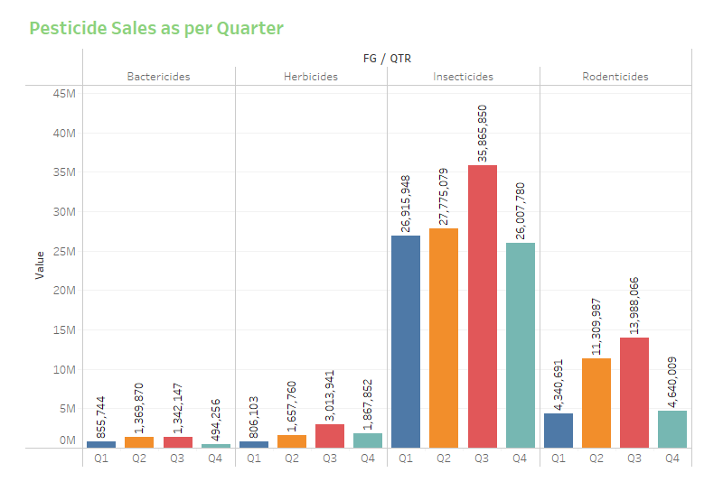
Market Analysis
Most sold chemicals in different quarters?
As per above graph that is Quarterly following are the observations
Out of four quarter Q3 is highest sold Quarter.
Out of four products Insecticides is most sale product.

Slide 5
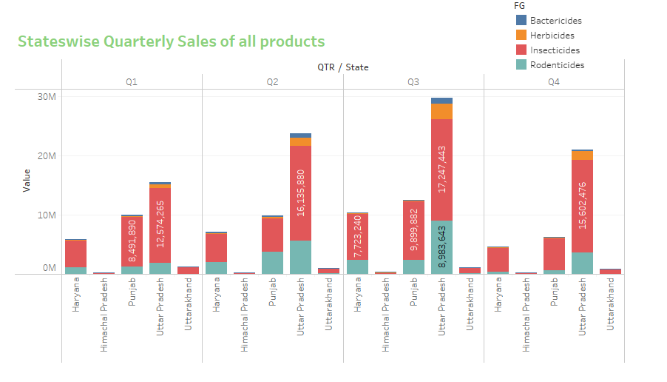
State level chemical sale in different quarters?
As per above graph that is States wise quarterly sales of all products following are the observations
Among all states Utter Pradesh is highest selling states in all quarter.
Among all Pesticide Insecticides is highest selling product in all states and all quarter.

Slide 6
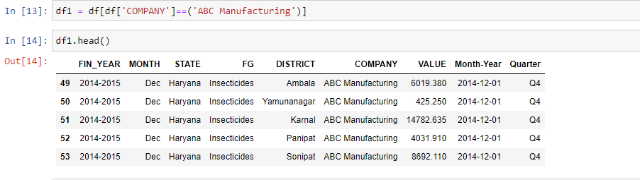
Data Analysis
For
ABC Manufacturing

Slide 7
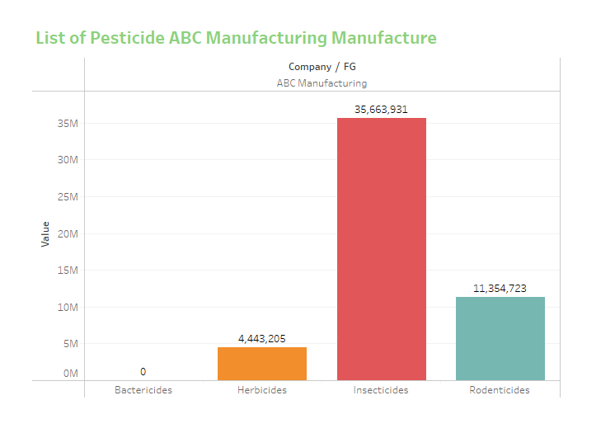
Which all chemicals does ABC Manufacture sale?
ABC Manufacturing not selling Bactericides.
Insecticides is highest selling product of ABC Manufacturing.

Slide 8
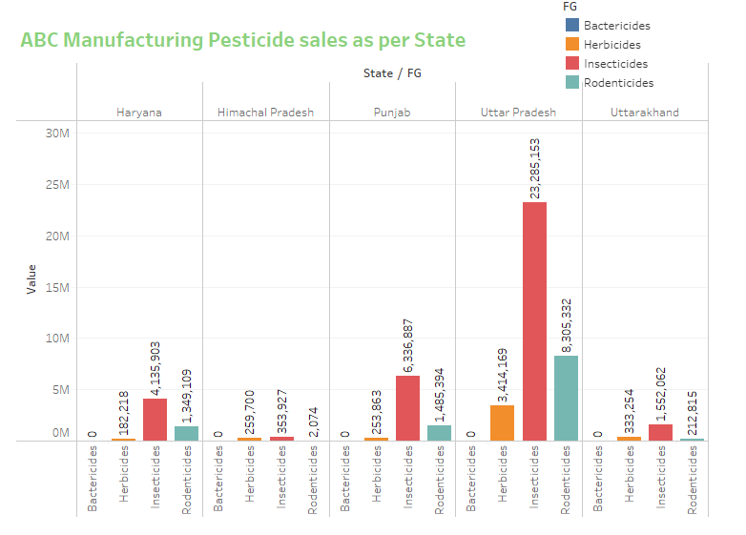
Which all states ABC manufacturing dominates and for which chemicals
As per above graph that is ABC Manufacturing Pesticide sales as per States following are the observations:-
For ABC Manufacturing Uttar Pradesh is highest selling states.
Insecticides is the highest selling product among all products.
For ABC Manufacturing Himachal Pradesh is lowest selling states.

Slide 9
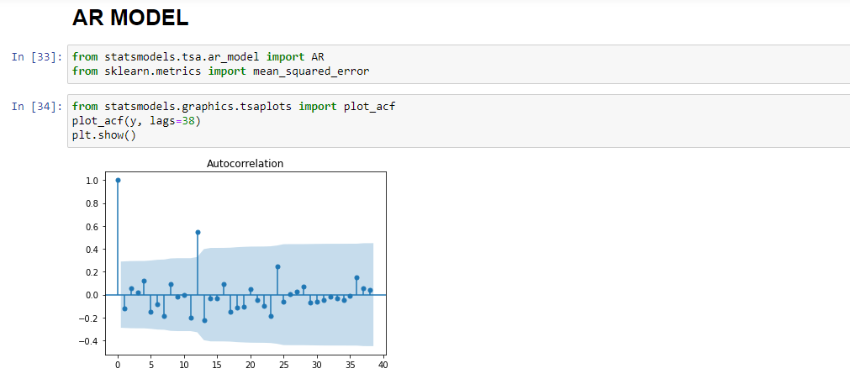
Testing AR MODEL on ABC Manufacturing DATA

Slide 10
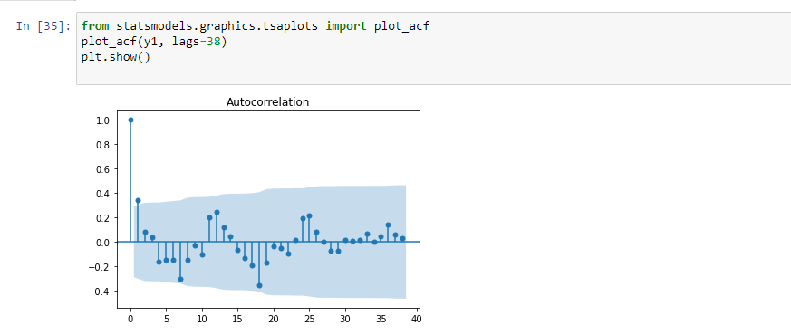
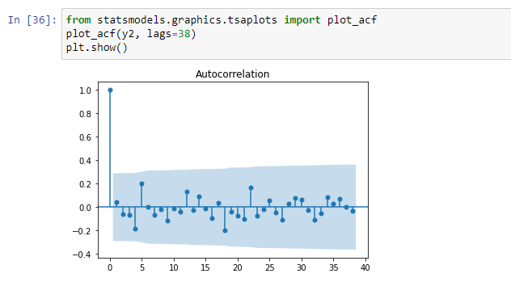
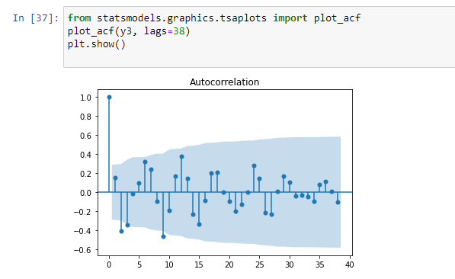
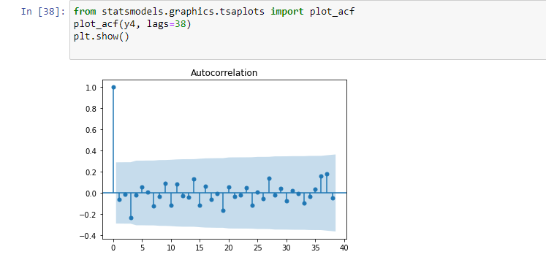

Slide 11

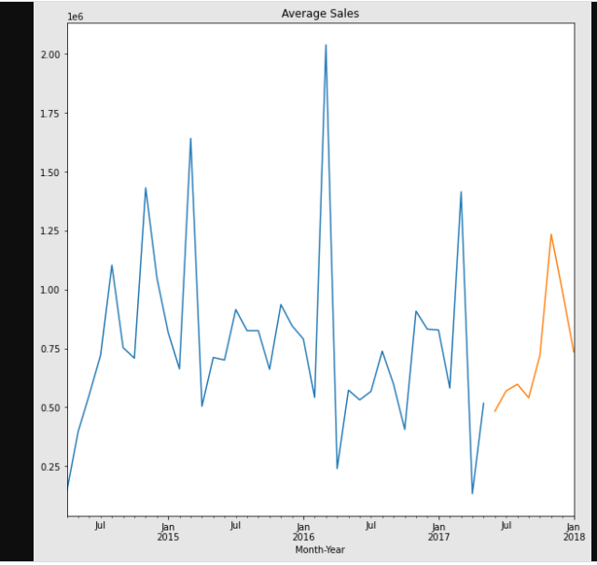

Slide 12
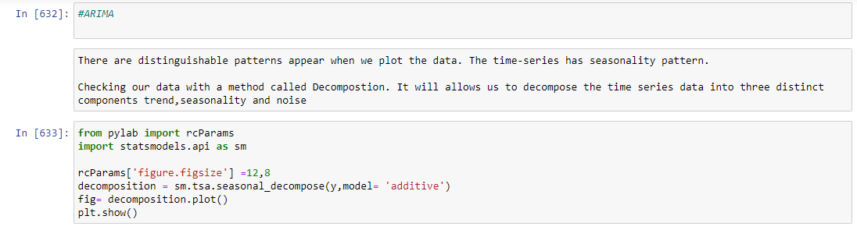

Slide 13
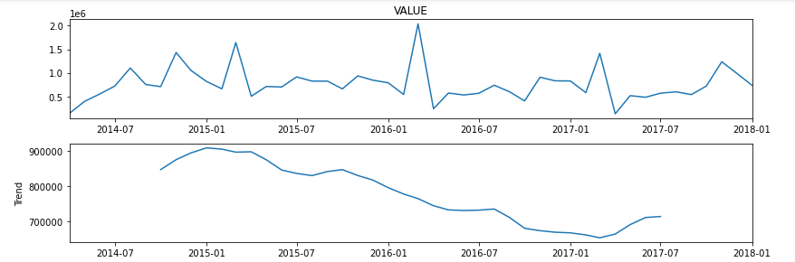
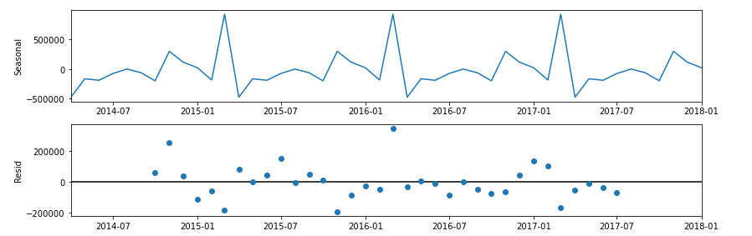

Slide 14
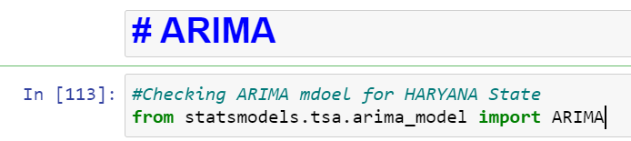
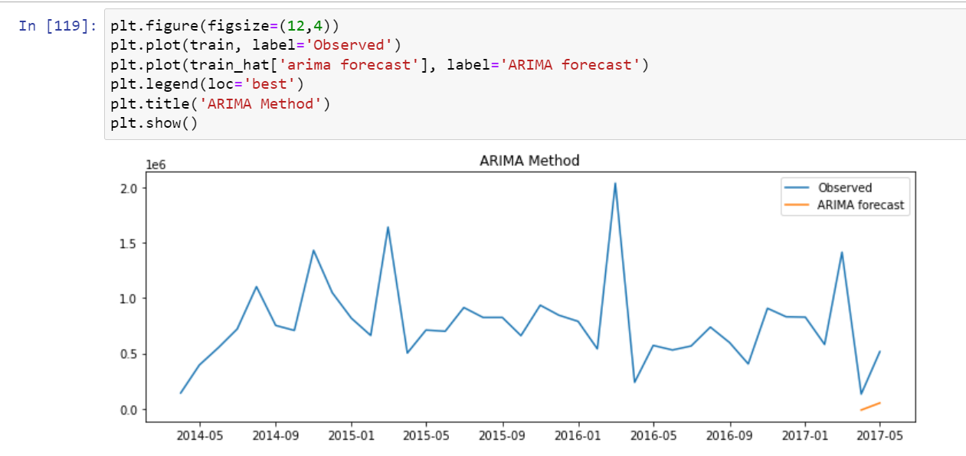

Slide 15
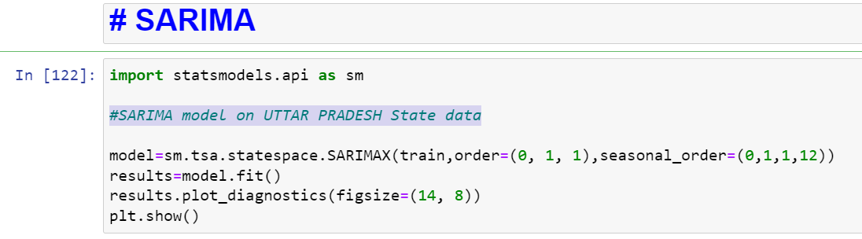
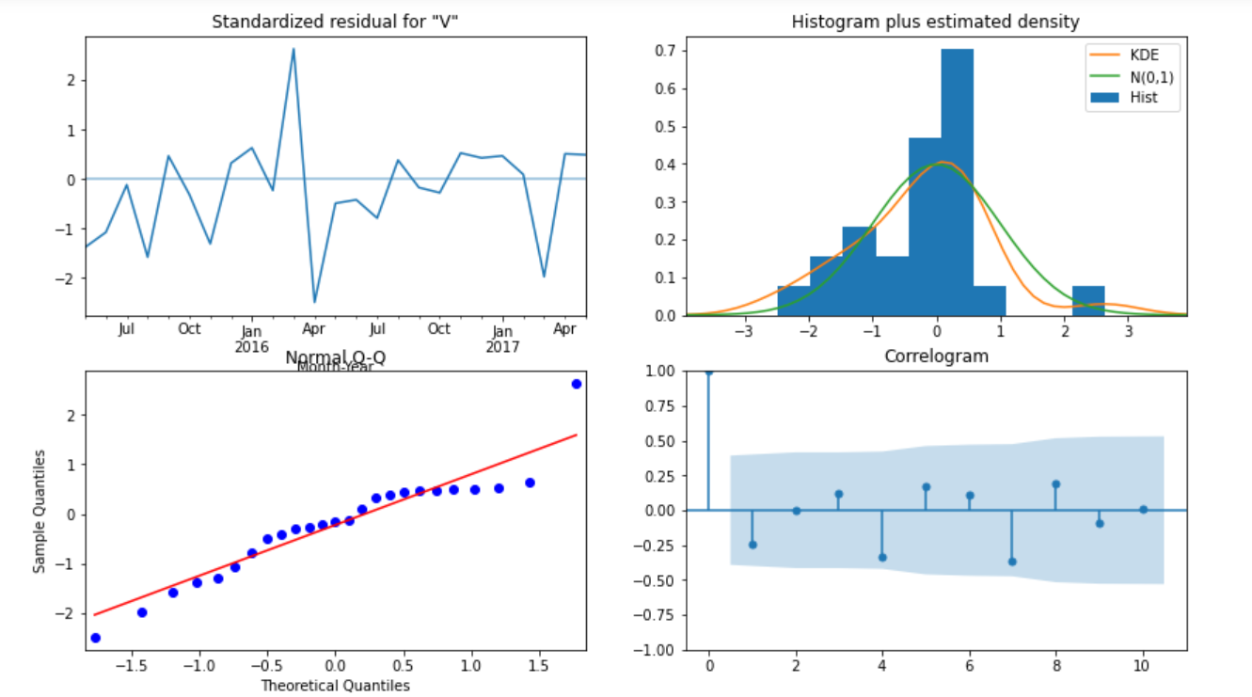

Slide 16
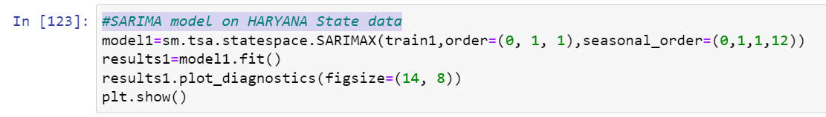
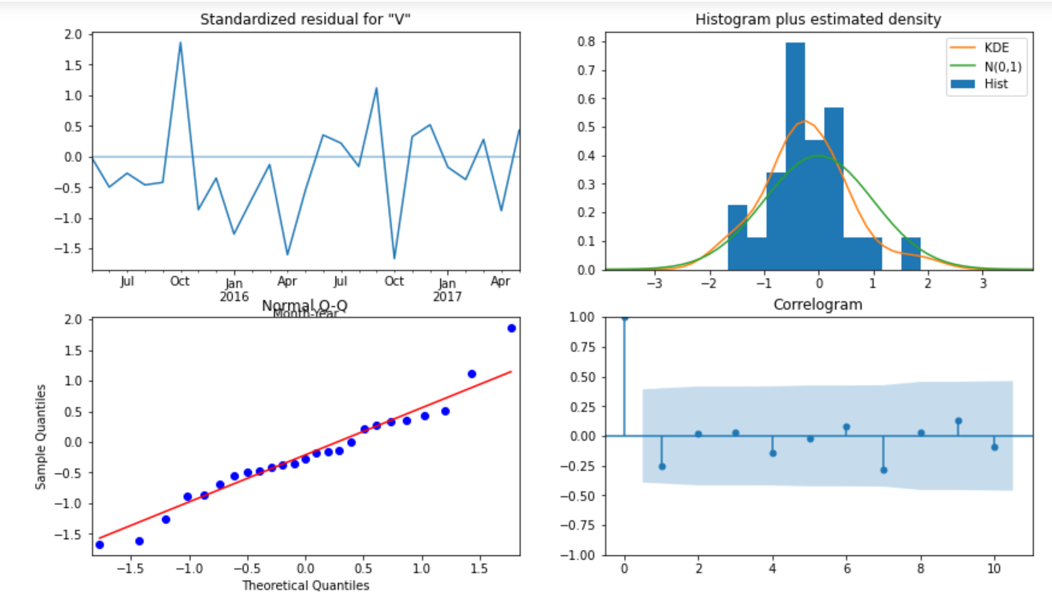

Slide 17
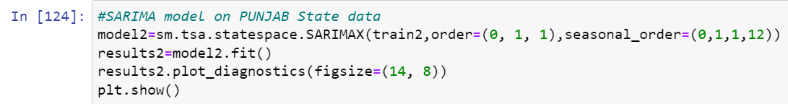
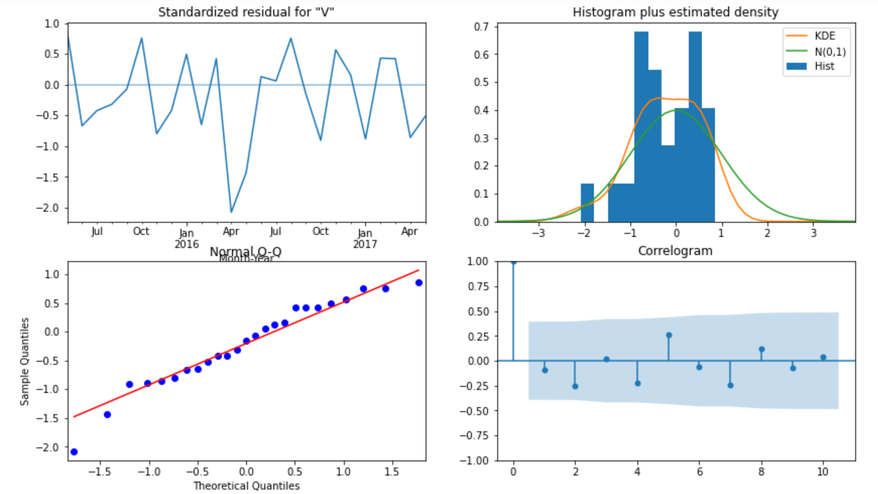

Slide 18
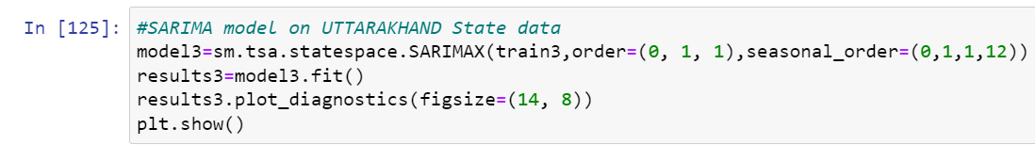
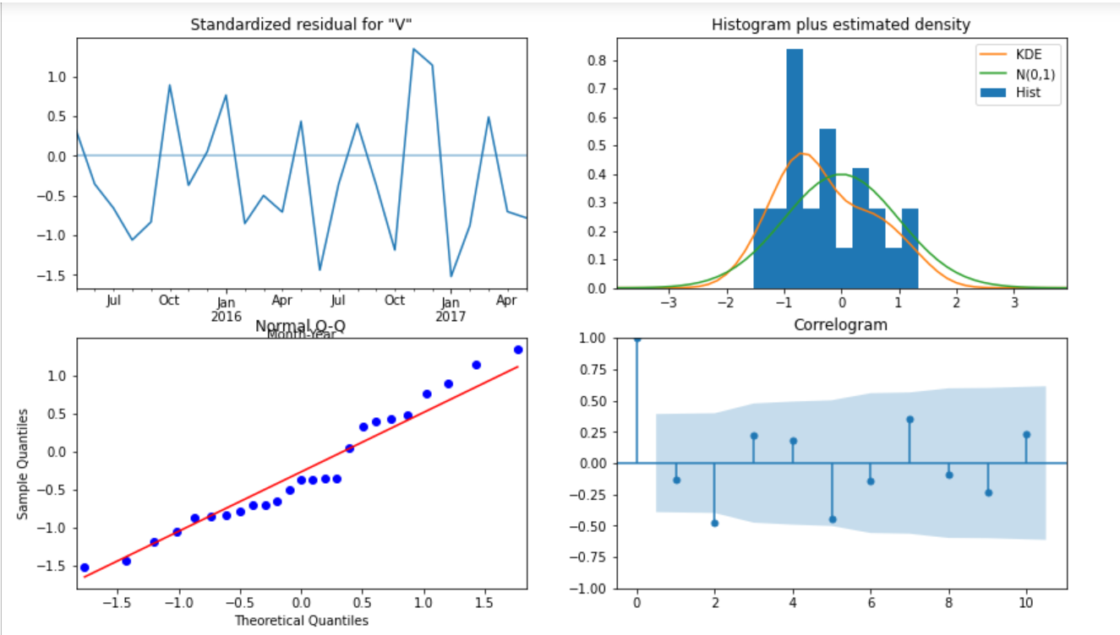

Slide 19
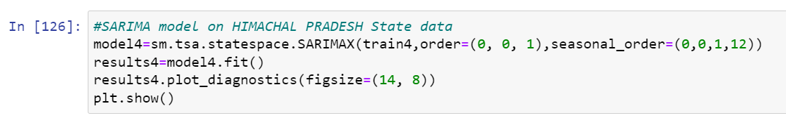
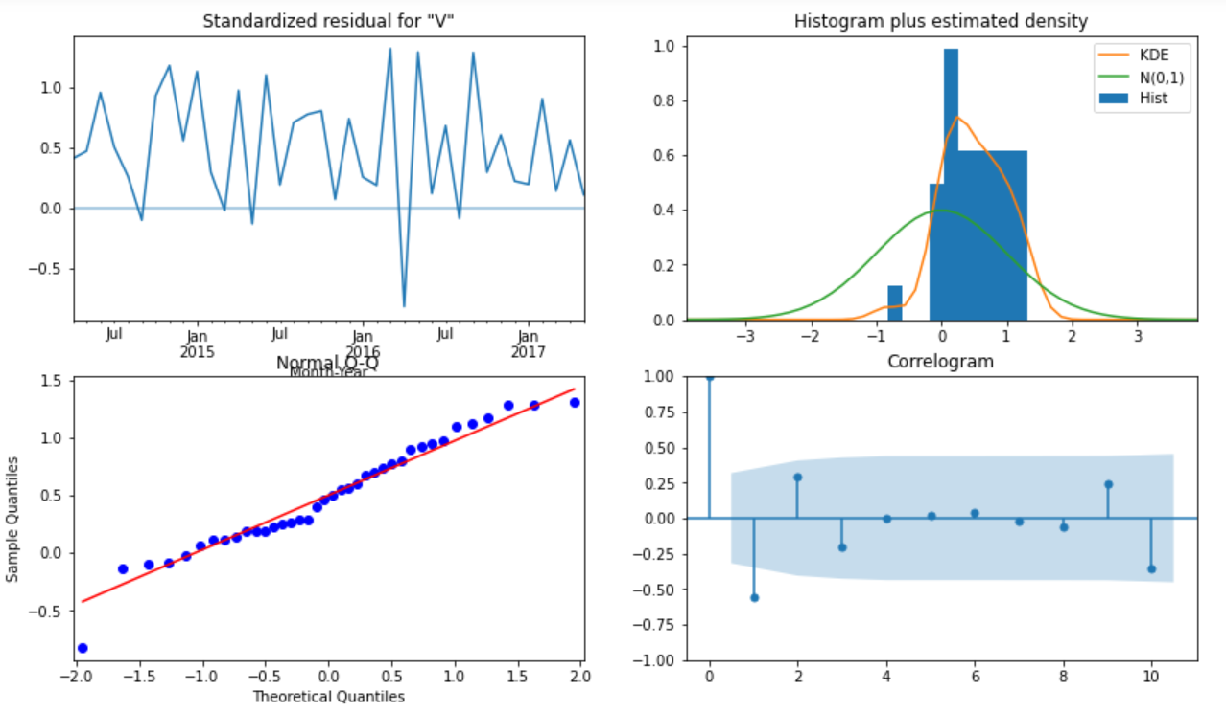

Slide 20
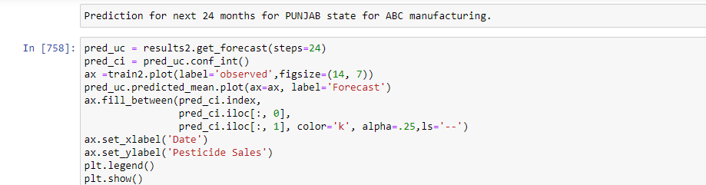
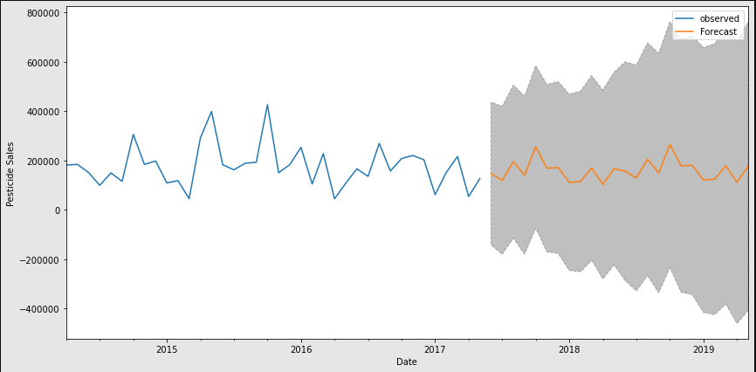

Slide 21
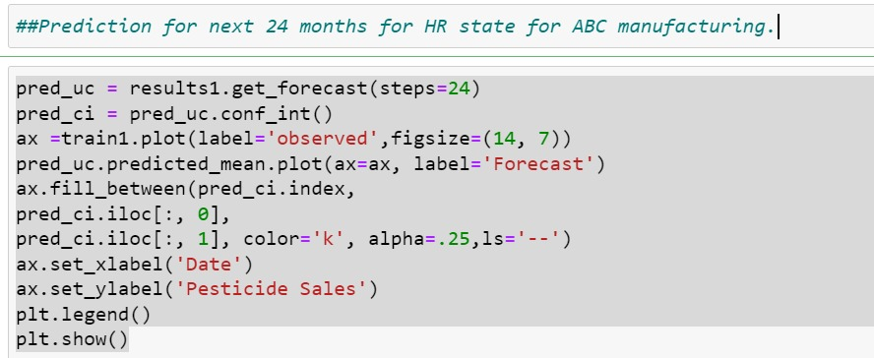
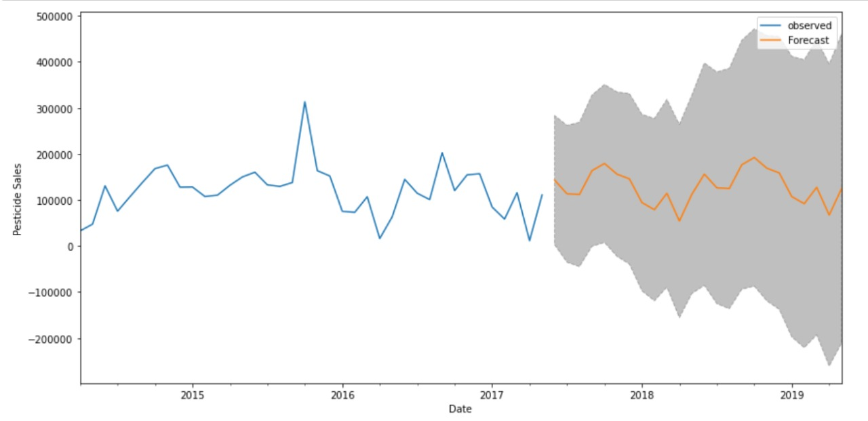

Slide 22
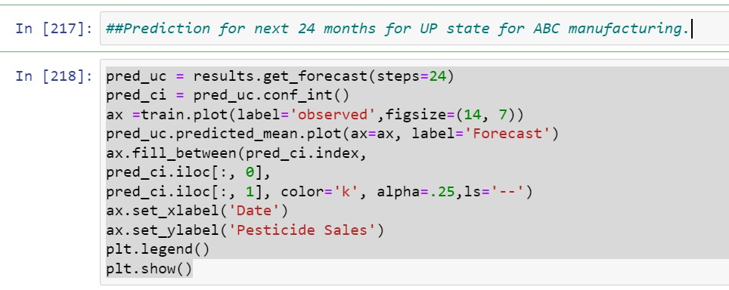
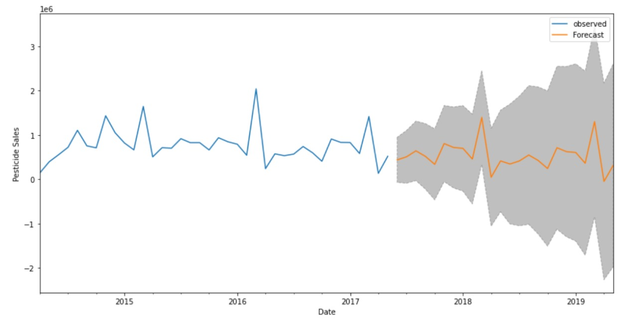

Slide 23
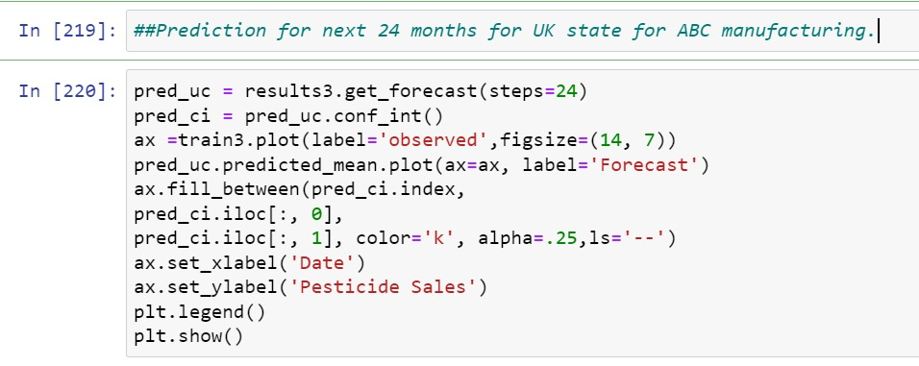
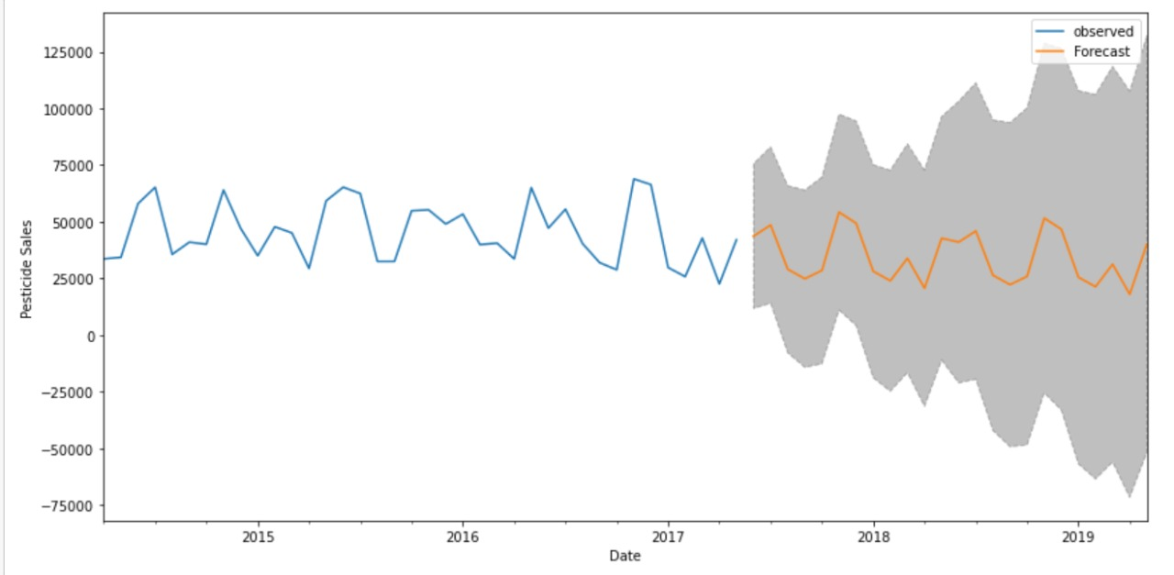

Slide 24
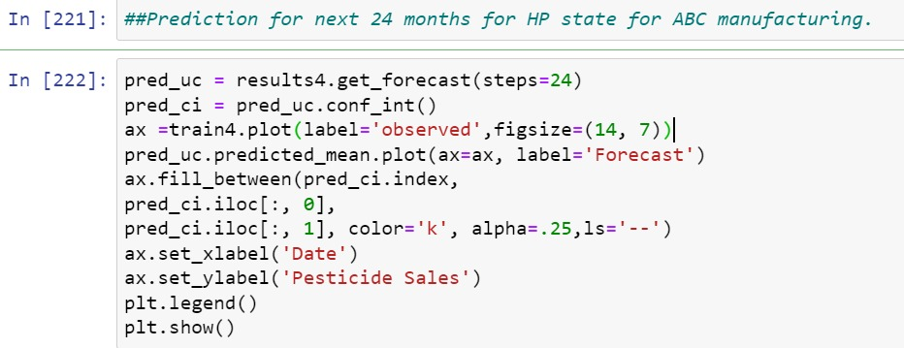
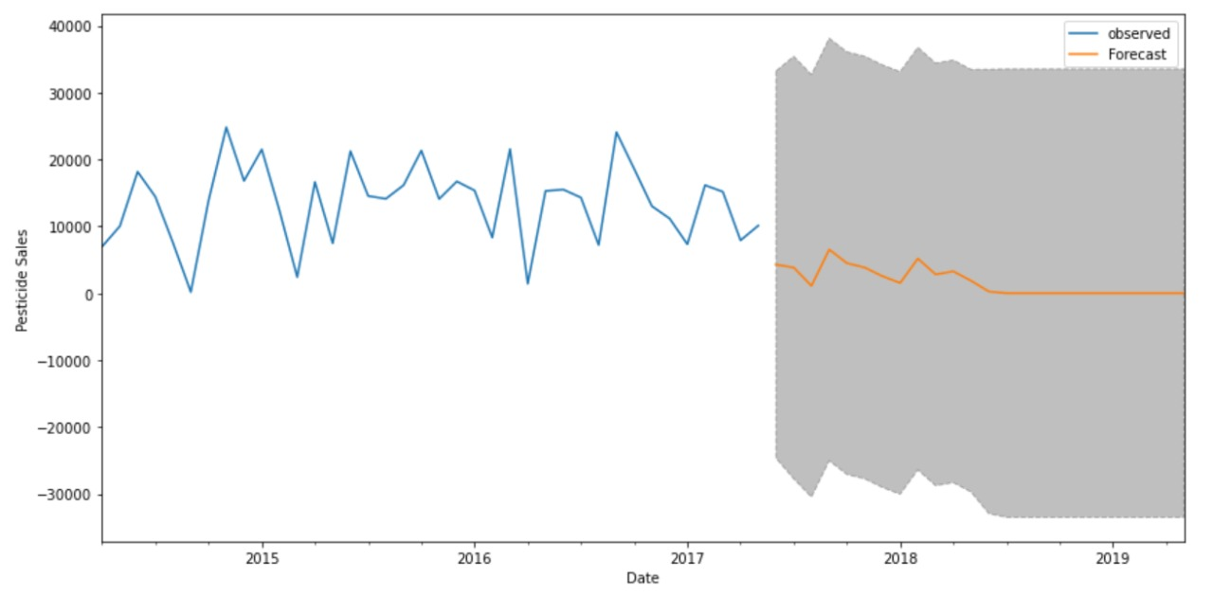

Slide 25
Conclusion
As per the observation, the RMSE for ARIMA is less than prophet modelling. So, we can go ahead with SARIMA model.
As per the Prediction for next 24 months state wise graphs we can say that ABC Manufacturing Company is good to Growth for Punjab, Haryana, Uttar Pradesh, Uttarakhand.
Company needs to slow down his manufacturing for Himachal Pradesh.

